Slide 1
Database Programming II

Slide 2
Overview
2
Overview of Design Pattern
Data Access Object (DAO).
DAO Design Pattern.
Applying DAO Design Pattern and OOP.
Exercise.

Slide 3
Overview of Design Pattern
Authors, Erich Gamma, Richard Helm, Ralph Johnson and John Vlissides published a book titled Design Patterns - Elements of Reusable Object-Oriented Software (1994), which initiated the concept of Design Patterns in Software development. The authors are collectively known as Gang of Four (GOF), and according to them, design patterns are primarily based on the following principles of object-oriented design (OOD):
Program to an interface, not an implementation.
Favor object composition over inheritance.
The software/application design pattern is a general, reusable solution to a commonly occurring problem within a given context in software design. It is not a finished design that can be transformed directly into source or machine code. It is a description or template for how to solve a problem that can be used in many different situations.
Design patterns are best practices that programmers can employ to overcome common design difficulties, and are solutions to general problems that software developers faced during software and application development. These solutions were obtained by trial and error by numerous software developers over a substantial period of time.

Slide 4
Usage of Design Pattern
Design Patterns have two main uses in software development:
Common platform for developers.
Design patterns provide standard terminology, and are specific to a particular scenario. For example, a Singleton design pattern signifies use of a single object so that all developers familiar with a single design pattern will make use of a single object, and can verify that the program is following a single pattern.
Best Practices for developers.
Design patterns have evolved over a long period of time, and they provide best solutions to certain problems faced during software development. Learning these patterns helps inexperienced developers learn software design in a fast and easy way.

Slide 5

Data Access Object Patterns
Introduction :–
Data Access Object (DAO) is a pattern that provides an abstract interface to some type of database or other persistence mechanism.
DAO Design Pattern is used to separate the data persistence logic into a separate layers. This way, the service remains completely in the dark about how the low-level operations access the database. This is known as the principle of Separation of Logic.
DAO is used to separate low-level data accessing API (like JDBC) or operations from high-level business services or the idea is to abstract or hide the database logic from the business layer.
img src: medium.com
Click here for more information about DAO.

Slide 6
Data Access Object Patterns (continued)
The advantage of using data access objects is the relatively simple and rigorous separation between two important parts of an application that do, but should not know of each other, and which can be expected to evolve frequently and independently.
If we need to change the underlying persistence mechanism, we only have to change the DAO layer, and not all the places in the domain logic where the DAO layer is used.

Slide 7
Data Access Object Pattern Components
DAO - Data Access Object Interfaces - This interface defines the standard operations performed on the model object(s). The interfaces provide a flexible design.
DAO - Data Access Object classes - This class implements above the interface, and is responsible for getting data from a data source, which can be a database / xml or any other storage mechanism. The interface implementation is a concrete implementation of the persistence logic.
DAL - Data-Access Layer - DAL is made up of interface and implementation classes for DAO. This layer provides easy and simplified access to data stored in persistent storage, such as an entity-relational database or any database, in applications. This layer is between the Service Layer and the storage layer.
Model Classes / DTO - This object is simple POJO class containing getter and setter methods to store data retrieved using DAO class.
DataSource: A data source could be a database such as an RDBMS, File,, XML repository, flat file system, or any other data source. A data source can also be another system service or some kind of repository.

Slide 8
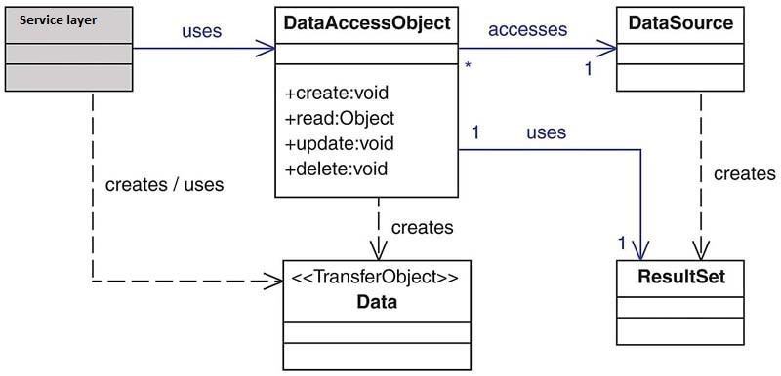
Data Access Object Pattern Components (continued)
High-level Class Diagram representing the relationships for the DAO Pattern.
Img Source: Per Scholas. 2022
Notes:
Data transfer object(DTO), if multiple requests are required to bring data for a particular task, data to be brought can be combined in a DTO so that only one request can bring all the required data.

Slide 9
Data Access Object - DAO
3
This is the primary object of a DAO design pattern.
DAO is an object that provides an abstract interface to some type of database or any other persistence storage. By mapping the application calls to the persistence layer, the DAO provides some specific data operations without exposing the details of the database.

Slide 10

DAO Design Pattern
6
Data Access Object
Business
Object
uses
connects
Data
Source
creates / uses
Transfer Object

Slide 11
The Old Process
8
Repeat for every DAO:
Connect to database – Same every time.
Create cursor – Same every time.
Prepare and issue statement.
Obtain data from database.
Close the connection – Same every time.

Slide 12
The New Process - Applying DAO Pattern and OOP
9
Start with ConnectionDAO class:
connect() method:
▶ Connect to database.
▶ Create cursor.
close() method:
▶ Close the connection.
Create class for queries
Create classes for each DAO:
Implement methods:
▶ start with connect method, provide logic, and end with close method.
Create main function:
Create DAO object and call the methods.

Slide 13
Example: Applying DAO Pattern and OOP - continued
Step1: Defining ConnectionDAO class
Create a python file names “DAOdemo.py”, and add below in it.
Note: In this example, we will use “usersdb” database. If you do not have that database, you must create database by the name of “usersdb” in MySQL
import mysql.connector as dbconnect
class ConnectionDAO:
con = None
cur = None
@classmethod
def connect(cls):
cls.con= dbconnect.connect(host='localhost',database='usersdb',user='root', password='password',port='3306')
cls.cur = cls.con.cursor()
@classmethod
def close(cls):
if not cls.con:
cls.con.close()

Slide 14
Example: Applying DAO Pattern and OOP - continued
Step2: Defining Queries class
In “DAOdemo.py” file add a below code
class Queries:
create_user_t = "CREATE TABLE user (email VARCHAR (100),name VARCHAR (50),password VARCHAR (30))"
insert_users = "INSERT INTO user(email, name, password) values('Tony@perscholas.org','haseeb','letsgomets'), ('John@perscholas.org','John','iwillnottellyou')"

Slide 15
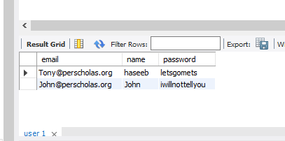
Example: Applying DAO Pattern and OOP - continued
Step3: Defining UserDAO class and Main() function
In “DAOdemo.py” file add a below code
class UserDAO (ConnectionDAO):
def generate_data(self):
UserDAO.connect()
UserDAO.cur.execute(Queries.create_user_t)
UserDAO.con.commit()
UserDAO.close()
def generate_user_table(self):
UserDAO.connect()
UserDAO.cur.execute(Queries.insert_users)
UserDAO.con.commit()
UserDAO.close()
def main():
u = UserDAO()
u.generate_data()
u.generate_user_table()
main()
Result:
After execution the code, user table must create in a database along with two records as shown in a screenshot below

Slide 16
Exercise: Task for you
User Table - Applying DAO Pattern and OOP
13
Starting with the given code, implement the other four methods applying DAO Pattern and OOP:
get_all_users()
get_user_by_name(name)
validate_user(email, password)
update_user(email, name, password)

Slide 17
Exercise: User Table - Applying Transfer Object
14
Modify the current program to use Transfer Object:
Create User class with the instance variables associated with each field in the user table.
Modify the following methods:
▶ get_all_users() should return a list of User objects instead of printing out the values of the current users.
▶ get_user_by_name(name) should return a User object instead of printing out the value of the user.
▶ update_user(user) should take a User object as an argument instead of email, name, and password.
▶ main() should print out the result.

Slide 18
Exercise: User Table - Getting Input
15
Modify the current program for the following requirements:
Modify the main() method to take input from the console when calling the following methods from UserDAO object:
▶ get_user_by_name(name).
▶ validate_user(email, password).
▶ update_user(user).

Slide 19
Exercise: User Table - Further Abstraction
16
Modify the current program for the following requirements:
Create UserRunnable class with the following methods:
▶ generate_user_table().
▶ get_all_users().
▶ get_user_by_name(name).
▶ validate_user(email, password).
▶ update_user(user).
Each method should create a UserDAO object; invoke the appropriate method; take input from console; if necessary; and print out the result.
main() method should create a UserRunnable object and invoke its methods.

Slide 20
Exercise: User Table - Finishing up
17
Modify the current program for the following requirements:
Within the main() method, rather than invoking all methods, users should be given options to choose so that they can select which query/method they want to call.
*Optional
insert_user(user) – This method takes a User object as an argument and inserts a row into user table with the values from the object.
delete_table(table_name) – This method removes the table with the given name from the database.

Slide 21
Summary Review
18
Python Database API
Steps to use Python Database API
Import the API module
Open the database connection
Prepare and issue SQL statements to the database
Obtain the result from the database
Close the connection
Example
CREATE DATABASE, CREATE TABLE, INSERT, SELECT, LIKE
Exercise – user table

Slide 22

Questions?
19

Slide 23

End of Module
20

